Slide 1
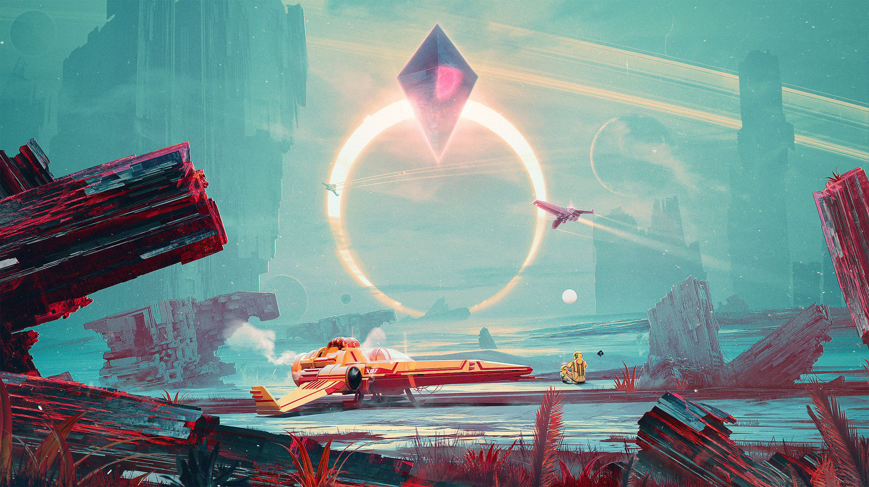
Creative Making: Advanced Visualisation and Computational Environments
An approach to iterative, playful, interactive spaces

Slide 2
Today you will learn about: Design tools for emotional design
What is a game What is play Basic game elements Systems Dynamics Emergence

Slide 3
Visceral Design
- Is what nature does - Dominates physical features - Has the same rules all over the world - Is about initial reactions - Can be studies quite simple by putting people in front of a design and waiting for reactions - Is all about immediate emotional impact

Slide 4
Behavioral Design
- Is all about use - Is the aspect practitioners focus upon - Function comes first - Is to understand how people will play a game - Applying user-centered design - Human-centered, focusing upon understanding and satisfying the needs of the player - Has to be a fundamental part of the design process

Slide 5
Reflective Design
- Is all about the message, culture, the meaning of the product or its use - Evoking personal remembrance - Self-image - All about long-term experience

Slide 6
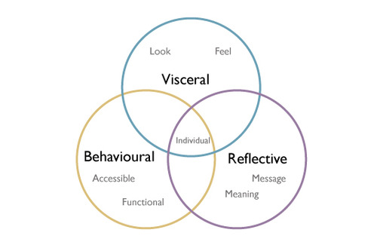
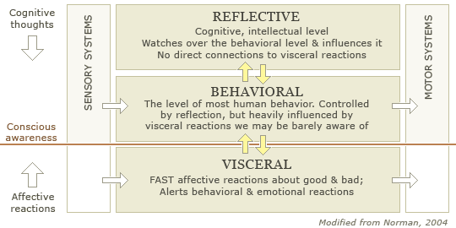

Slide 7
What is a game?

Slide 8
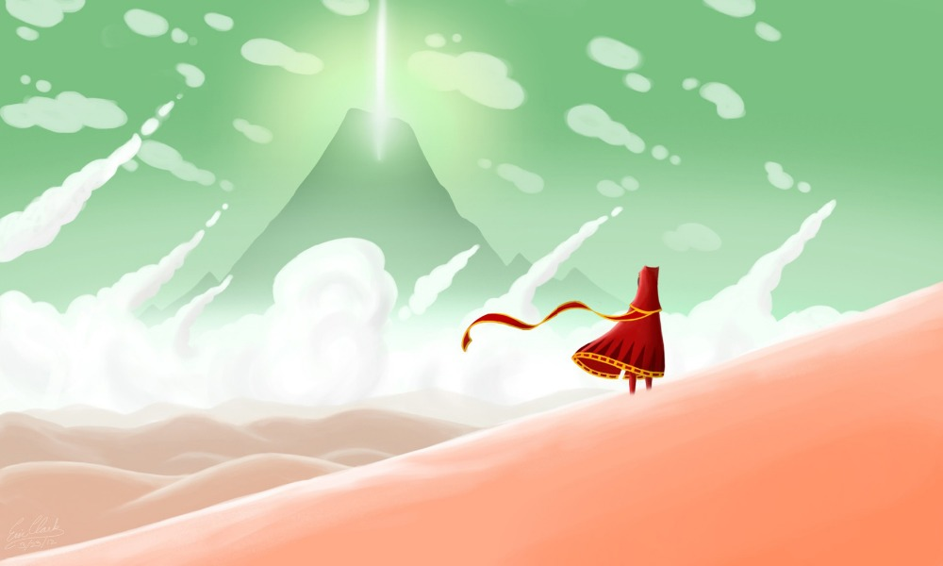
journey

Slide 9
Actions, rules, goals, objects

Slide 10

Actions: The activities players can carry out in pursuit of goals

Slide 11
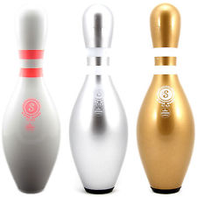
Goals: The outcome players try to achieve through play

Slide 12

Rules: The instructions for how the game works

Slide 13
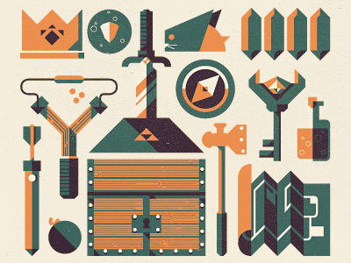
Objects: The things players use to achieve the game’s goals

Slide 14

Playspace: The space, defined by the rules, on which the game is played

Slide 15
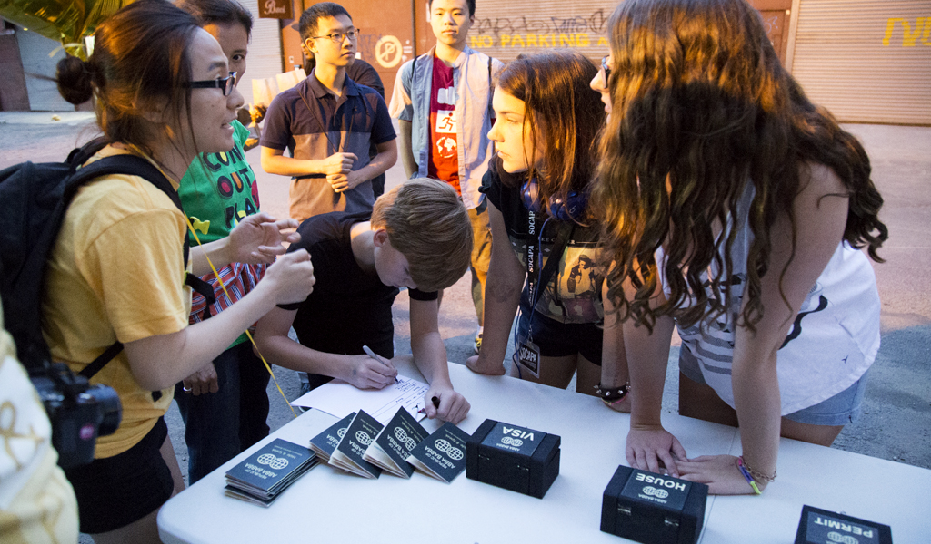
Players: Operators of the game

Slide 16
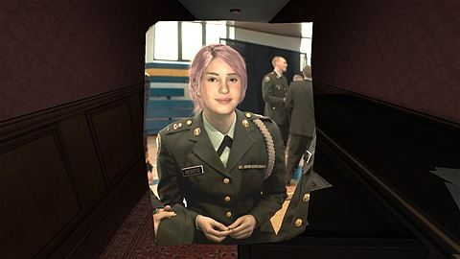
Second-order design: what we create through rules, actions & goals. Gone Home

Slide 17
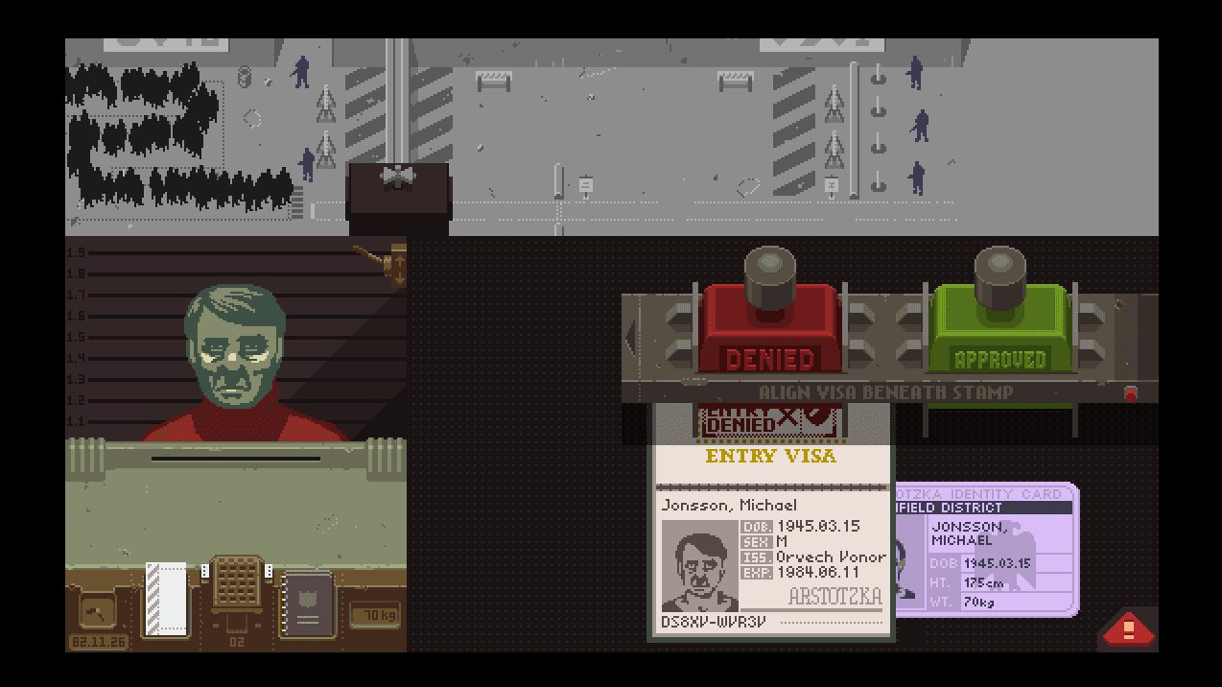
Space of possibilities: Papers Please

Slide 18
Game state

Slide 19

Constraint: Limits

Slide 20
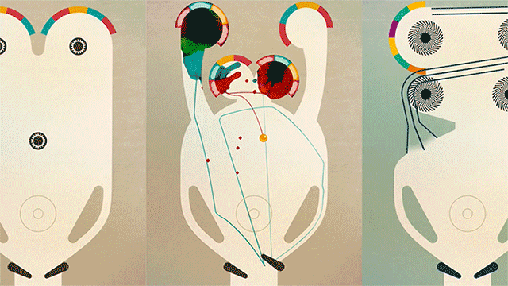
Direct and indirect action inks & proteus

Slide 21
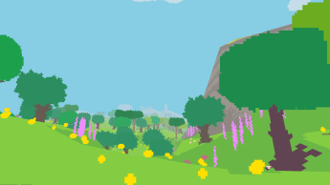
Direct and indirect action: Proteus

Slide 22
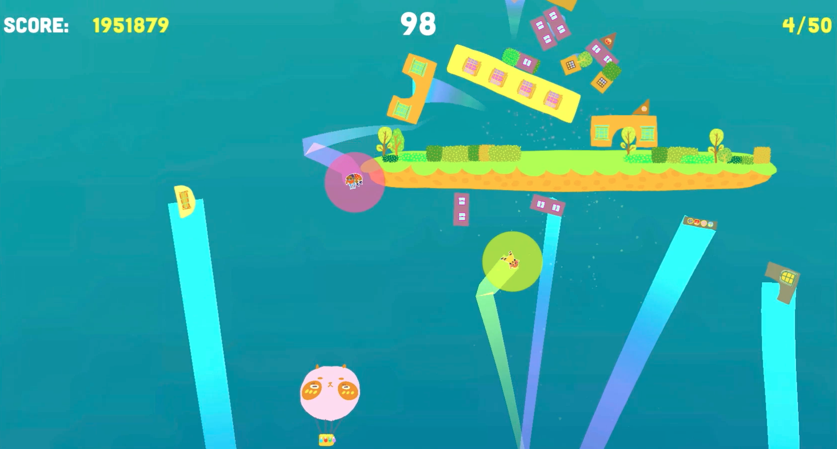
Goals: Slam City Oracles

Slide 23
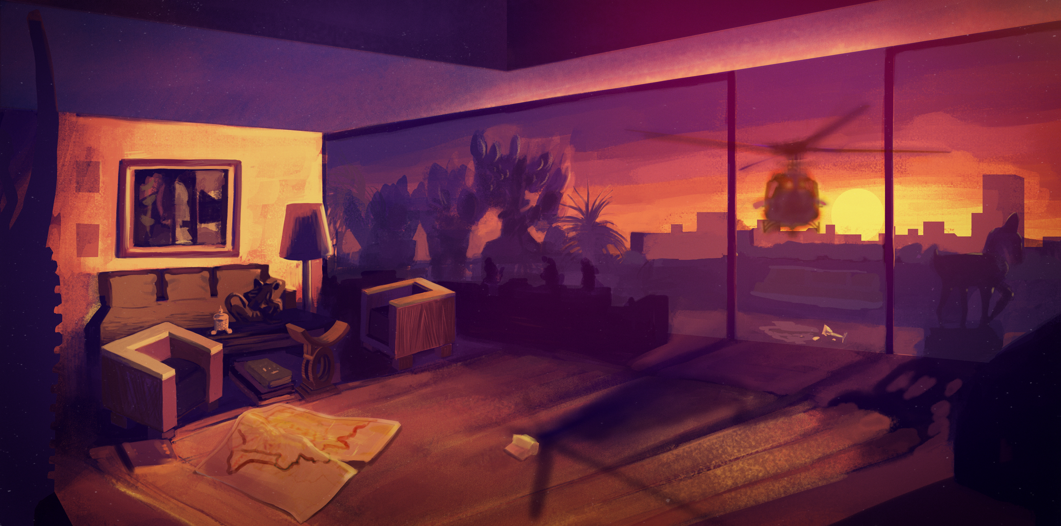
Goals: Sunset

Slide 24

Skill

Slide 25
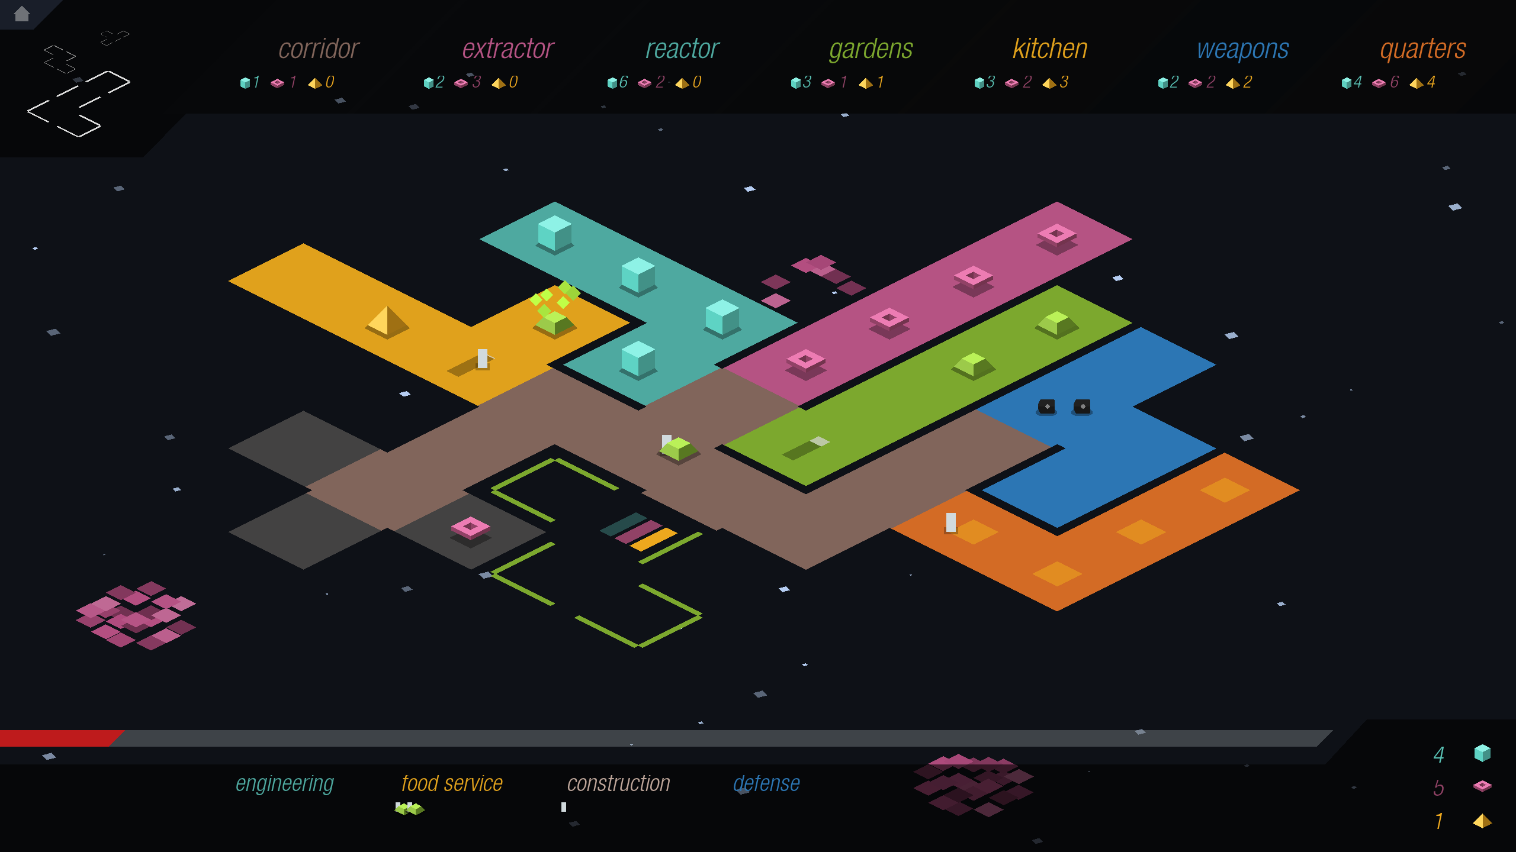
Strategy
Strategy

Slide 26

chance and uncertainty

Slide 27
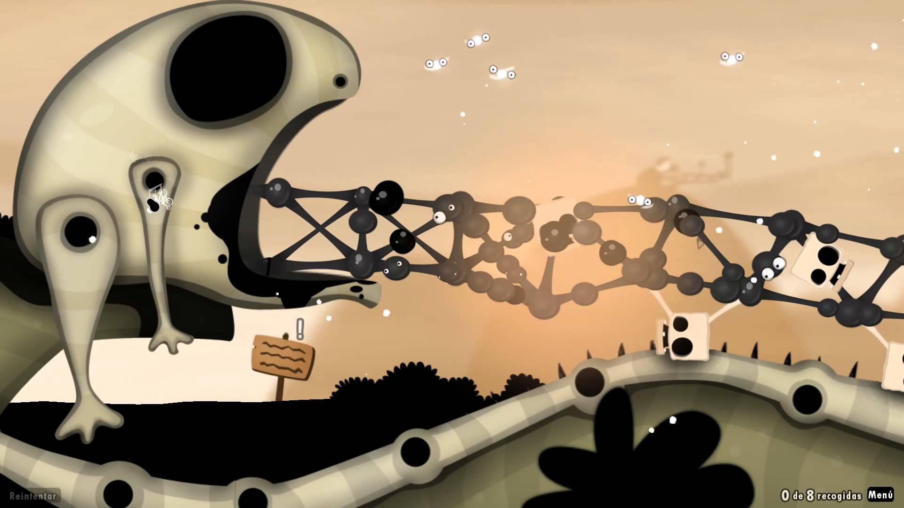
Decision-Making and Feedback: World of Goo

Slide 28
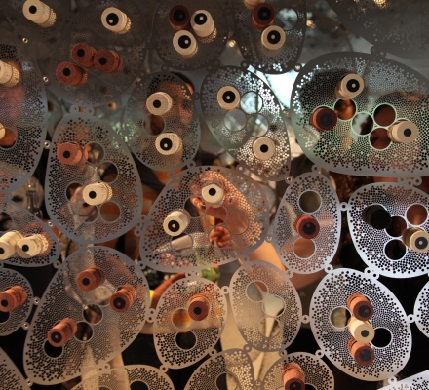
Abstraction

Slide 29
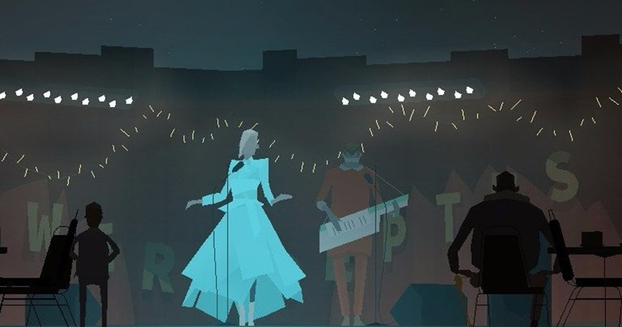
Theme

Slide 30

Storytelling

Slide 31

Contexts of Play: Pacmanhattan

Slide 32
Ludology: the study of games and play

Slide 33
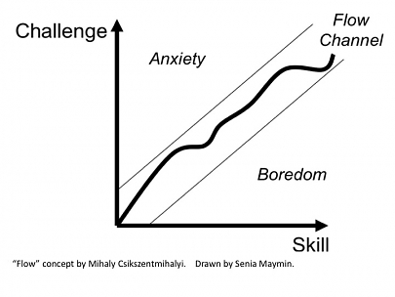
Challenge

Slide 34
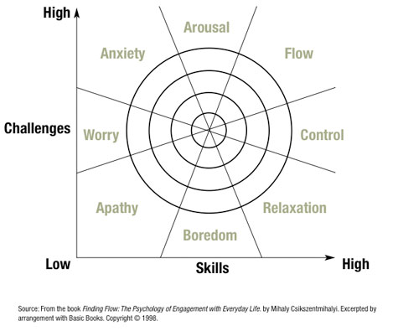
Absorption

Slide 35
What is Play?

Slide 36
Creating wonder

Slide 37

Play is this struggle between order and chaos, between the will to create and the will to destroy.

Slide 38
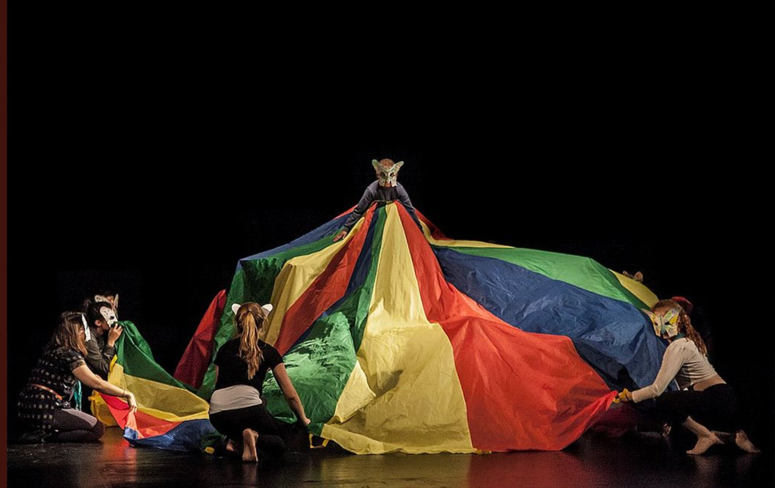
Play is carnivalesque Equilibrium between creation and destruction in the embodied laughter.

Slide 39
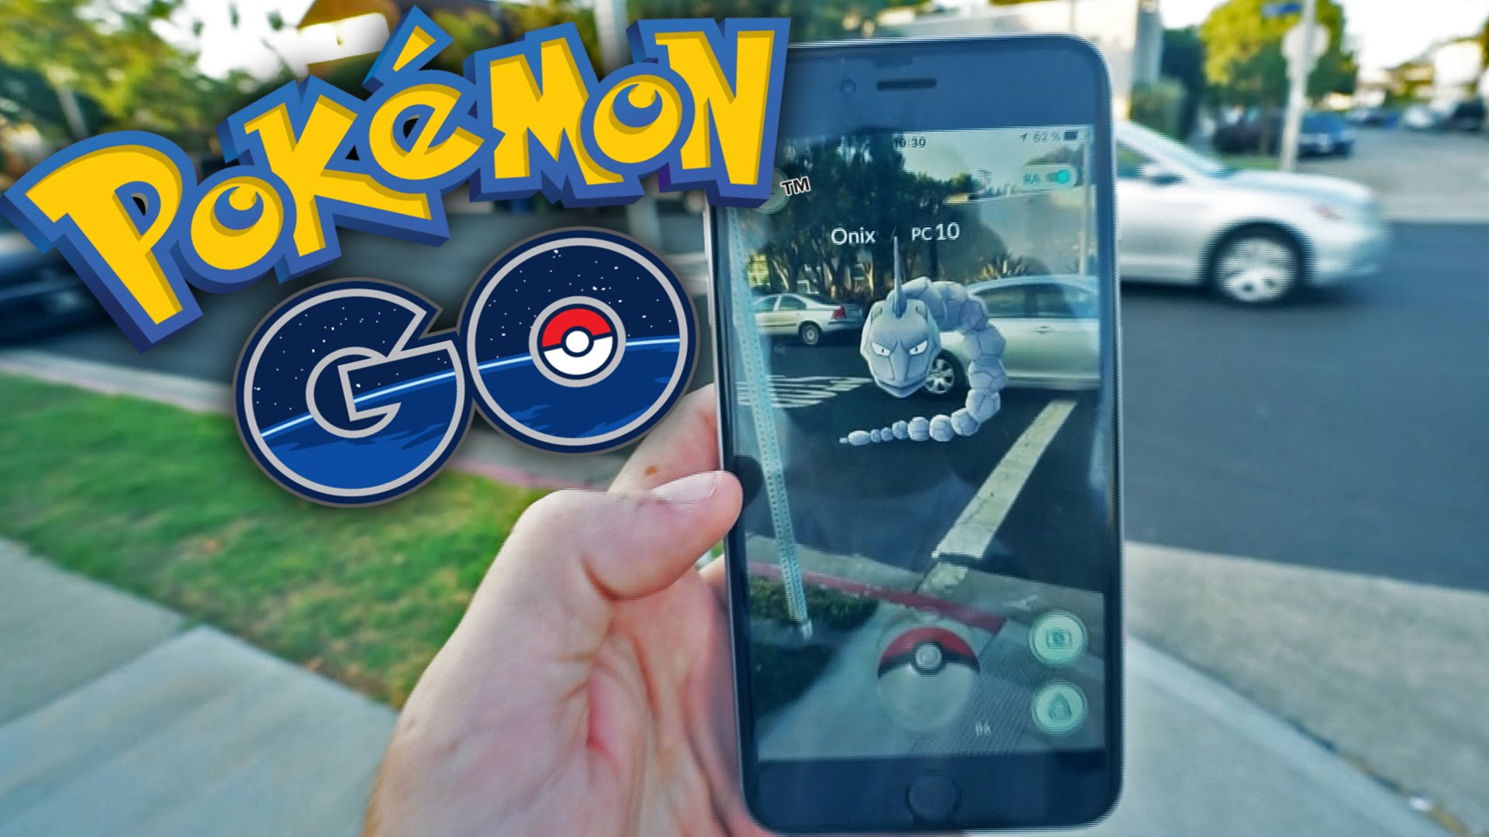
Play is appropriative It can take over the context it is embedded within

Slide 40

Dark play is an exploration of the wild side of play in which players decide to engage in an activity, like Camover, to force an emotional response in those who do not recognize they are actually playing

Slide 41
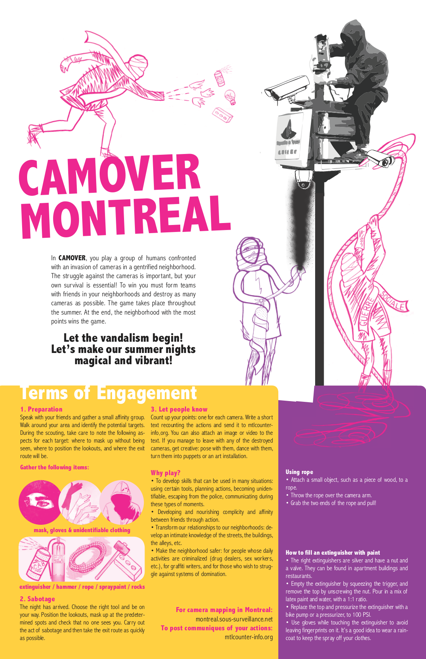

Slide 42
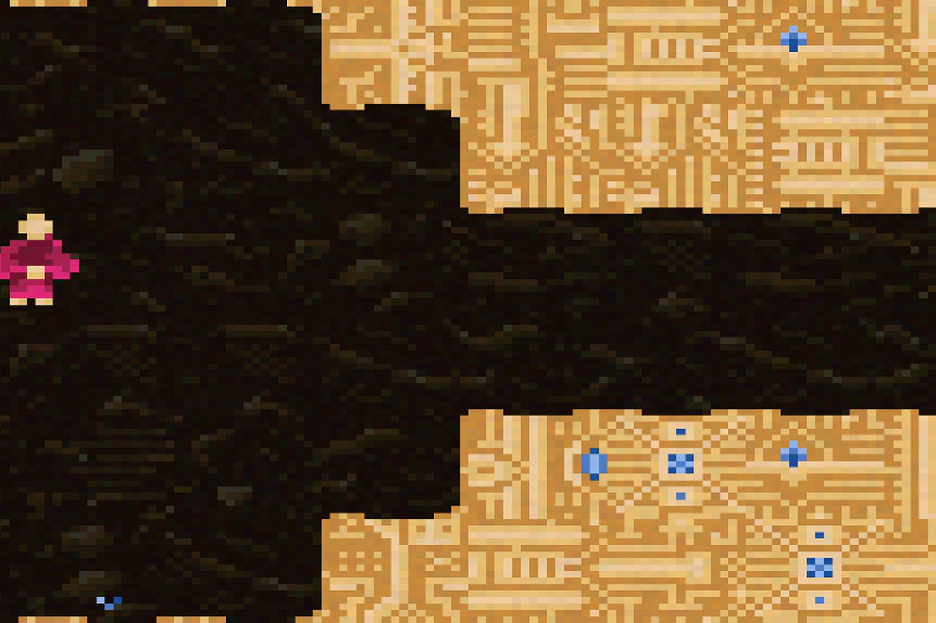
Play is autotelic— an activity with its own goals and purposes, with its own marked duration and spaces and its own conditions for ending.
Vesper.5 only lets each player make 1 move a day and takes 100 days to play

Slide 43
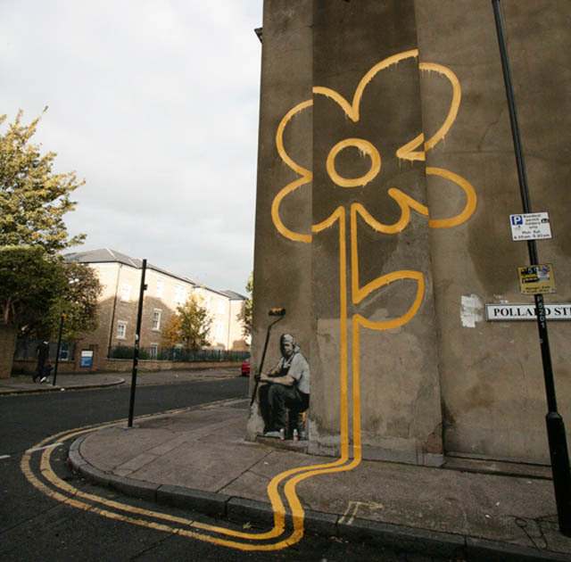
The main difference between play and playfulness is that play is an activity, while playfulness is an attitude.

Slide 44
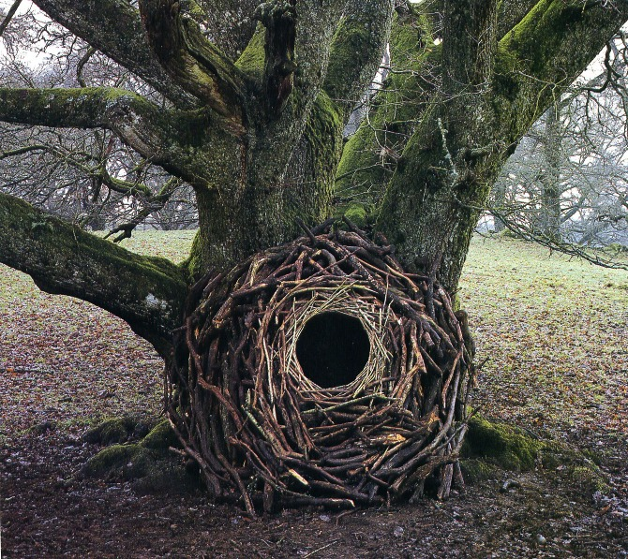
Playfulness glues together an ecology of playthings, situations, behaviors, and people

Slide 45
Emergence
larger systems arise through interactions among smaller or simpler systems such that the larger systems exhibit properties the smaller/simpler entities do not exhibit.

Slide 46
Conway’s Game of Life
In 1970, Martin Gardner wrote an article in Scientific American that documented mathematician John Conway’s new “Game of Life,” describing it as “recreational” mathematics and suggesting that the reader get out a chessboard and some checkers and “play.”

Slide 47
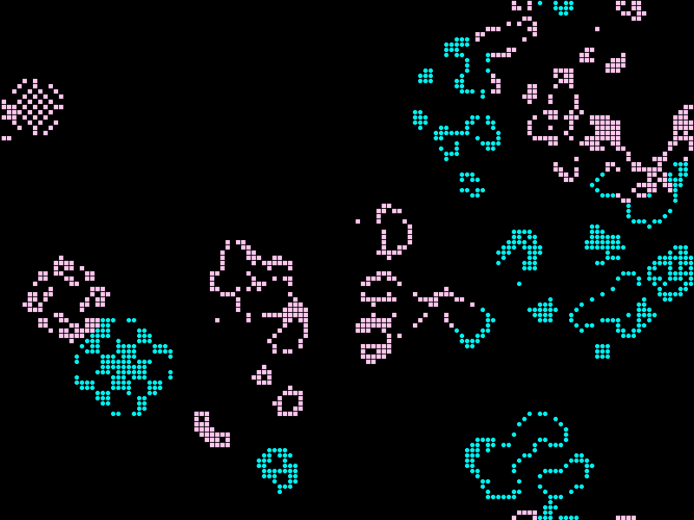

Slide 48
Perlin Noise
Perlin noise is a type of gradient noise developed by Ken Perlin in 1983 as a result of his frustration with the "machine-like" look of computer-generated imagery (CGI) at the time. He formally described his findings in a SIGGRAPH paper in 1985 called An image Synthesizer.

Slide 49


Slide 50
Systems Theory
Systems theory is the interdisciplinary study of systems. A system is a cohesive conglomeration of interrelated and interdependent parts that is either natural or man-made.

Slide 51
Systems Theory
spatial and temporal boundaries
surrounded and influenced by its environment
described by its structure and purpose or nature and expressed in its functioning.

Slide 52
Systems Theory
Changing one part of the system usually affects other parts and the whole system, with predictable patterns of behavior.
For systems that are self-learning and self-adapting, the positive growth and adaptation depend upon how well the system is adjusted with its environment.

Slide 53
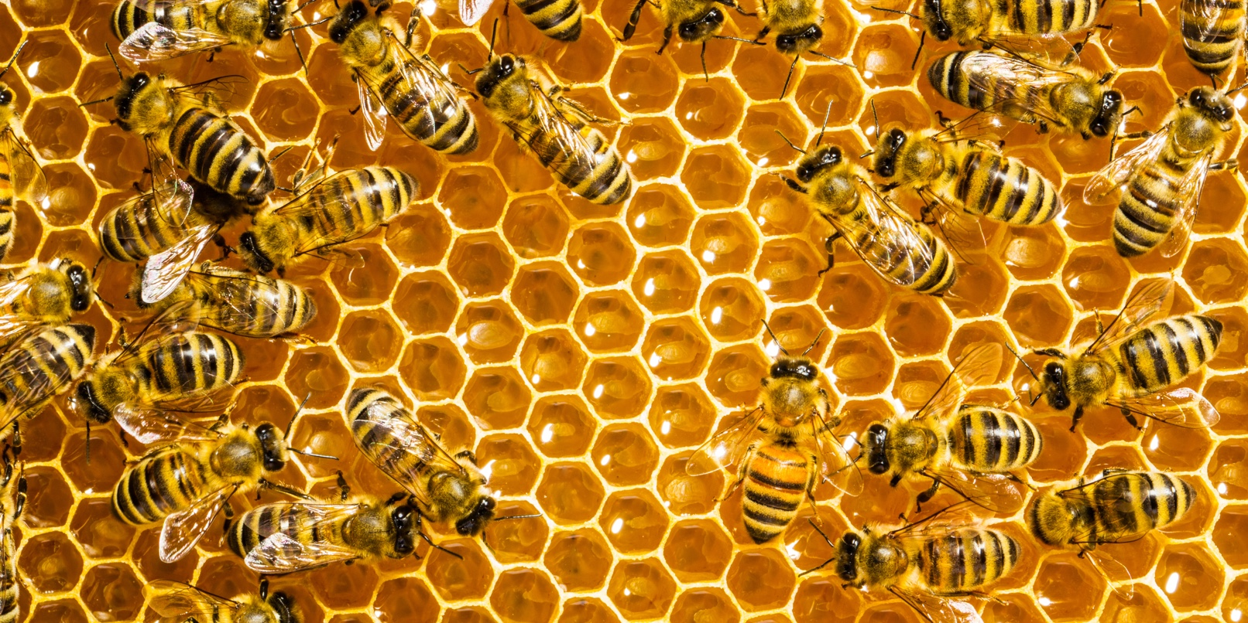
System Dynamics

Slide 54
System Dynamics
Games as systems of rules (mechanics) which come together to create system dynamics
Focus on the actions and interactions between parts
Games create play which in turn generate physical, intellectual and emotional responses (Visceral, Behavioral, and Reflective responses)

